Slide 1
Introduction to Time Series

Slide 2
Time Series
A sequence of observations of a quantifiable phenomenon recorded in increasing order of time
  Stock price
  Exchange rate, interest rate, inflation rate, national GDP
  Retail sales
  Electric power consumption
  Number of accident fatalities

Slide 3
Components of Time Series
Trend: The trend represents long term changes in the level of series. Indicate the general direction of the change of observed values
Seasonal Variations: The Seasonal factor is the periodic fluctuations of constant length that is usually caused by known factors such as rainfall, month of the year, temperature, timing of the Holidays, etc.
Cyclic Variations: Periodic component with period longer than seasonal period. Generally, trend and the cyclical component are analysed/estimated together
Noise or Irregular Variations: randomness in the data points that aren’t correlated with any explained trends. Noise is unsystematic and is short term.

Slide 4
Time Series Decomposition
One approach to the analysis of time series data is based on smoothing past data in order to separate the underlying pattern in the data series from randomness.
The underlying pattern then can be projected into the future and used as the forecast.
The underlying pattern can also be broken down into sub patterns to identify the component factors that influence each of the values in a series.

Slide 5
Time Series Decomposition
This procedure is called decomposition.
Decomposition methods usually try to identify two separate components of the basic underlying pattern that tend to characterize economics and business series.
  Trend Cycle
  Seasonal Factors

Slide 6
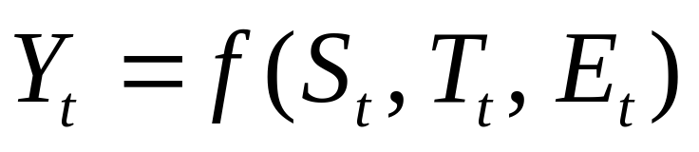
Decomposition Model
Mathematical representation of the decomposition approach is:
  Y_{t} is the time series value (actual data) at period t.
  S_{t} is the seasonal component ( index) at period t.
  T_{t} is the trend cycle component at period t.
  E_{t} is the irregular (remainder) component at period t.

Slide 7
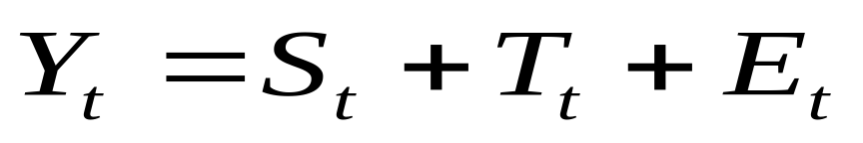
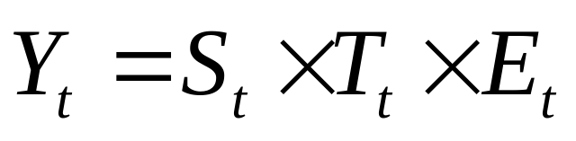
Decomposition Model
The exact functional form depends on the decomposition model actually used.
Two common approaches are:
  Additive Model:
  Multiplicative Model:

Slide 8
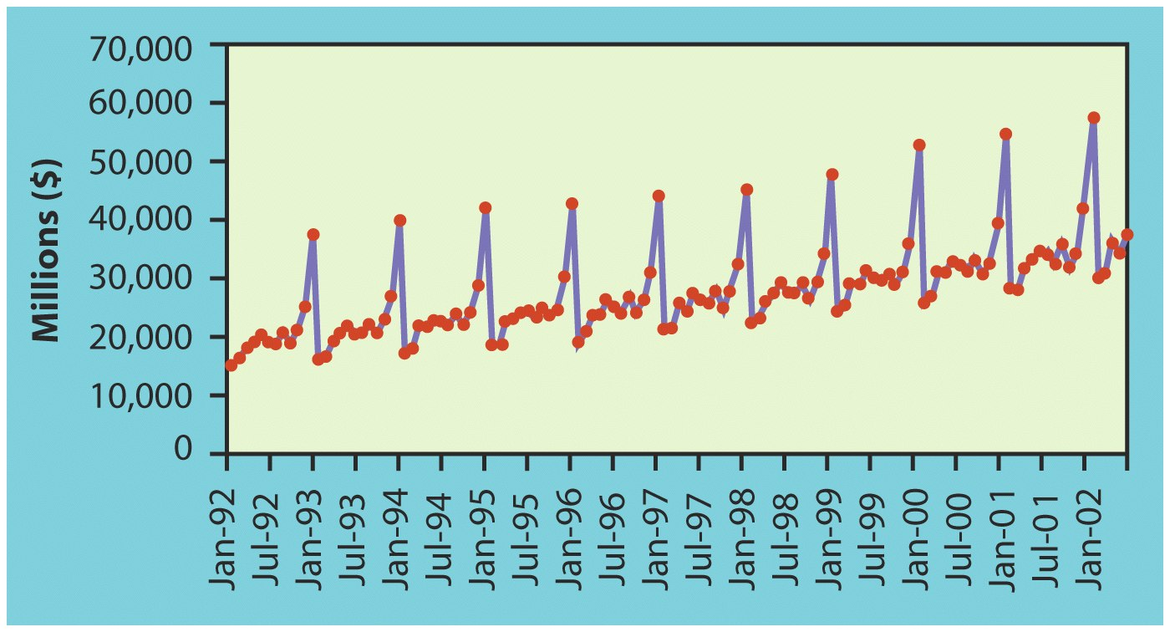
Decomposition Model
An additive model is appropriate if the magnitude of the seasonal fluctuation does not vary with the level of the series.
Time plot of U.S. retail Sales of general merchandise stores for each month from Jan. 1992 to May 2002.

Slide 9
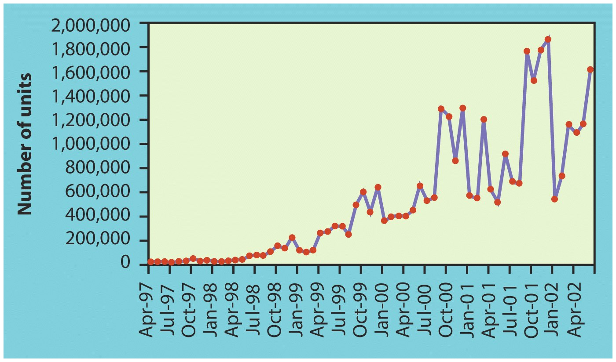
Decomposition Model
Multiplicative model is more prevalent with economic series since most seasonal economic series have seasonal variation which increases with the level of the series.
Time plot of number of DVD players sold for each month from April 1997 to June 2002.

Slide 10
Trend-Cycle Estimation
The trend-cycle can be estimated by smoothing the series to reduce the random variation.
There is a range of smoother available.
We will look at:
  Semi-average
  Moving Average
  Least Square Method

Slide 11
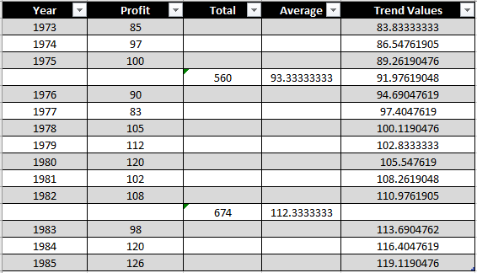

Semi-Average Method

Slide 12
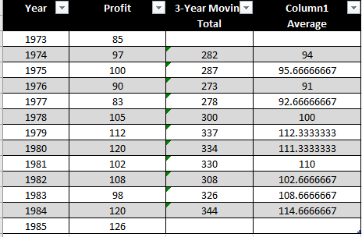
Moving Average Method

Slide 13
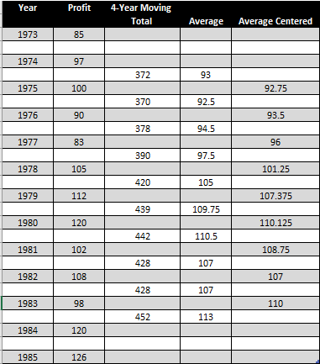
Moving Average Method

Slide 14
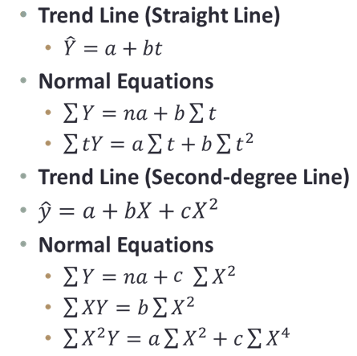
Least Squares Method

Slide 15
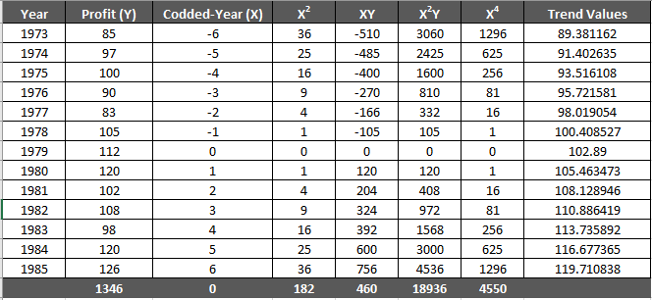
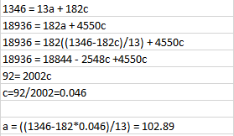
Least Squares Method

Slide 16
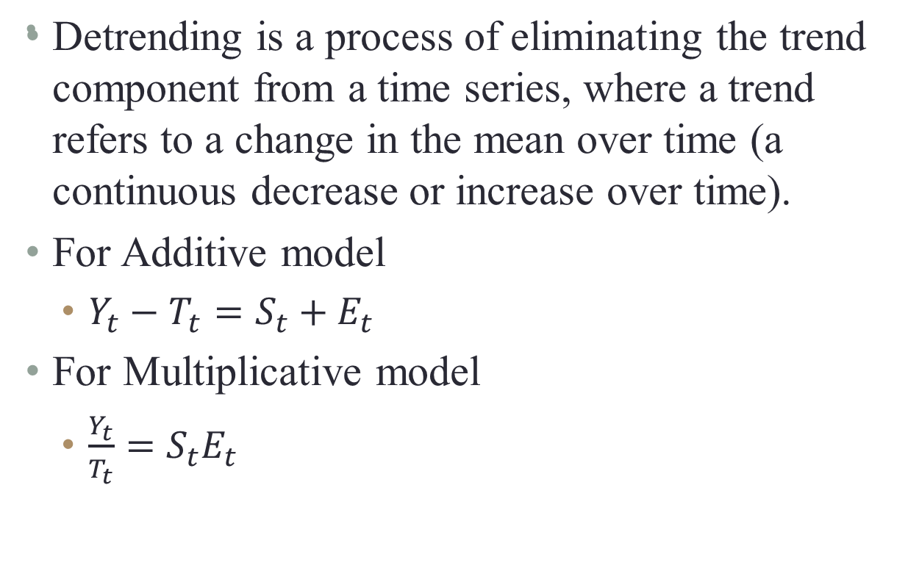
Detrending the time series

Slide 17
Analysing of Seasonal Variations
The percentage of annual-average method
The ratio-to-moving-average method
The ratio-to-trend method

Slide 18

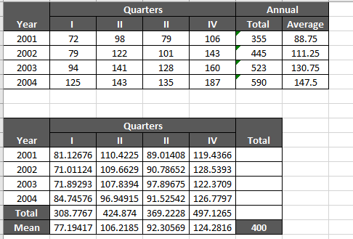
The Percentage-of-Annual-Average Method

Slide 19
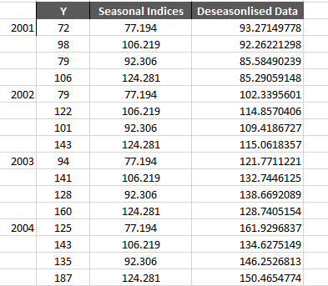
De-seasonalization of data

Slide 20
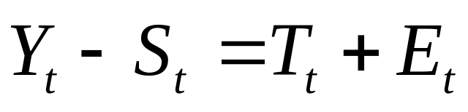
Seasonal Adjustment
A useful by-product of decomposition is that it provides an easy way to calculate seasonally adjusted data.
For additive decomposition, the seasonally adjusted data are computed by subtracting the seasonal component- Deseasonalization

Slide 21
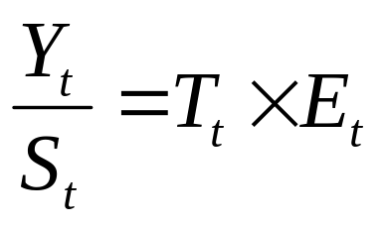
Seasonal Adjustment
For Multiplicative decomposition, the seasonally adjusted data are computed by dividing the original observation by the seasonal component.
Notes:
Example: For monthly unemployment we want to know whether an increase from one month to the next means a worsening in the economy. If the increase is due to the addition of a large number of school-leavers seeking work (a seasonal variation) we would not want to conclude the economy has weakened.

Slide 22
Deseasonalizing the data
Fore example:
Assume you are working for a manufacturer of major household appliances and heard that housing starts for the first quarter were $258.4
Since your sales depend heavily on new construction, you want to project this forward for the year.
We know that housing starts show strong seasonal components.
To make a more accurate projection you need to take this into consideration.
Suppose that the seasonal index for the first quarter of the housing start is 0.797

Slide 23
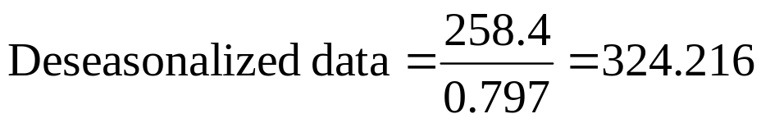
Deseasonalizing the data and Finding Seasonal Indexes
Once the Seasonal indexes are known you can deseasonalize data by dividing by the appropriate index that is:
Deseasonalized data = Raw data/Seasonal Index
  Therefore
Multiplying this deseasonalized value by 4 would give a projection for the year of $1,296.864

Slide 24
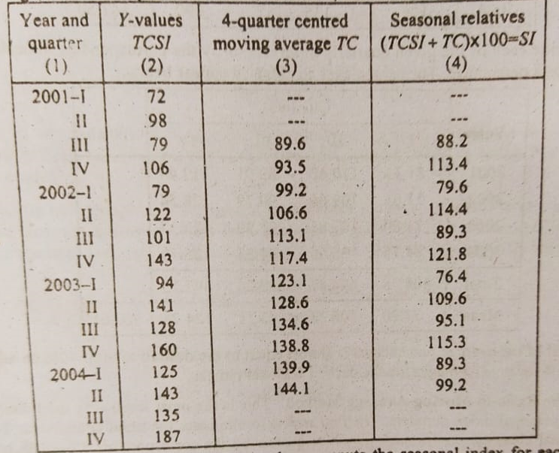
The ratio-to-moving-average method

Slide 25
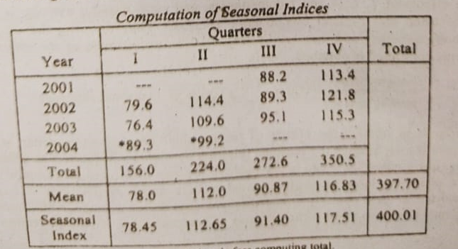

Slide 26
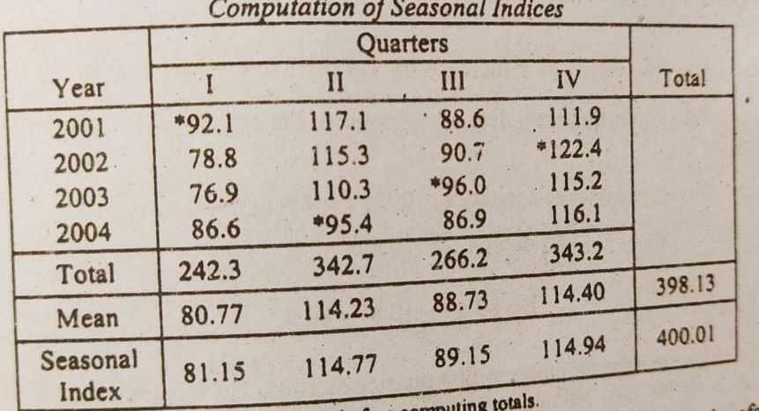
The ratio-to-trend method

